Slide 1




Final report
SleepOnTime
Group member: SIPENG WU
KEXIN LEI
XINYI ZHOU
HUIQING HUANG

Slide 2
Chapter 1 Difficulty and Effort of app Development
Difficulty
Effort

Slide 3


Difficulty of app Development
UI design
First time using figma and not yet familiar with this online ui design tool. It takes time to get up to speed.
Some components need to be made by ourselves.

Slide 4
Difficulty of app Development
Front-end development
The images in figma are not clear when exported.
The borders in Figma are difficult to export.
The colors in the interface are too similar.
The final pages are difficult to integrate
The colors in figma do not match in Android studio
It takes much time to adjust the colors

Slide 5
Difficulty of app Development
Back-end development
Obtaining access to your phone
Determine if the foreground application is this
application by detecting the application at the top of the activity stack, if not, close the foreground application and open this application. The problem here is that re-opening this application will restart an Activity instead of opening the original Activity, and therefore end the previous countdown.

Slide 6
Efforts we made
Face-to-face group meetings
Searching for the study materials online
Learn from the failures of others’ work

Slide 7
Chapter 2
The completeness of the app testing

Slide 8
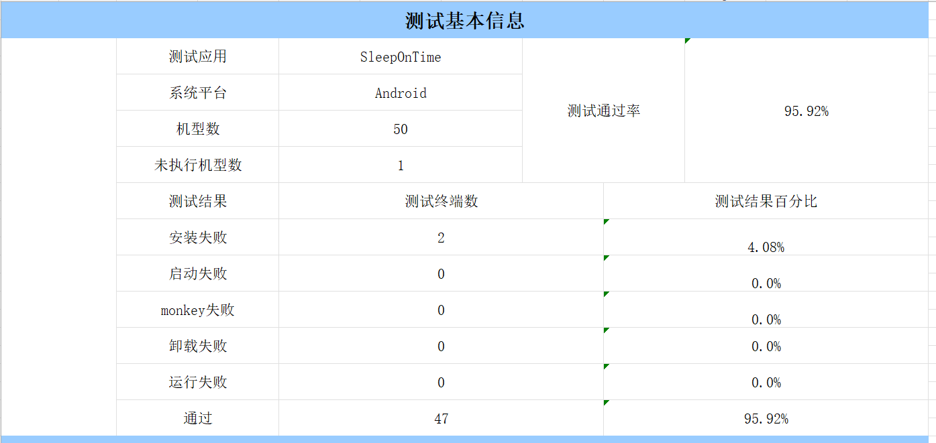
The completeness of the app testing
Ui测试
兼容性测试
安装卸载测试—真机调试
交互测试
客户端数据库测试

Slide 9
User Experience
Chapter 3
User experience and Improvement
effects
Improvement Effects

Slide 10
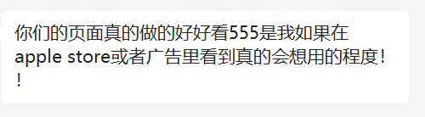
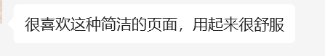
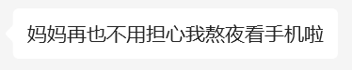
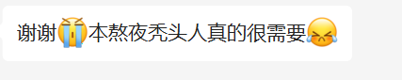
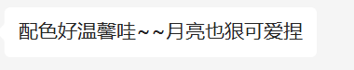
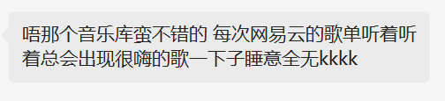
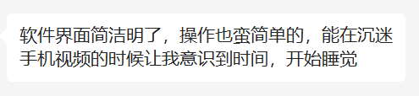
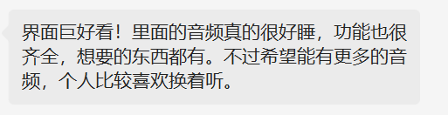
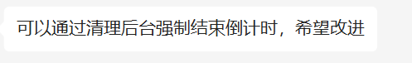
User Experience

Slide 11
User Experience
The countdown is forced to end while clearing
Fully functional
Easy to use,
The color scheme is so warm
Cute Moon~
Wish to have more music~
Mega nice!!
Makes me aware of the time to sleep
The audio inside is really helpful for sleeping
Log in with Wechat

Slide 12


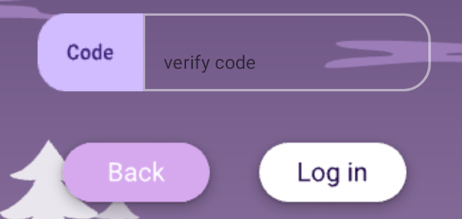
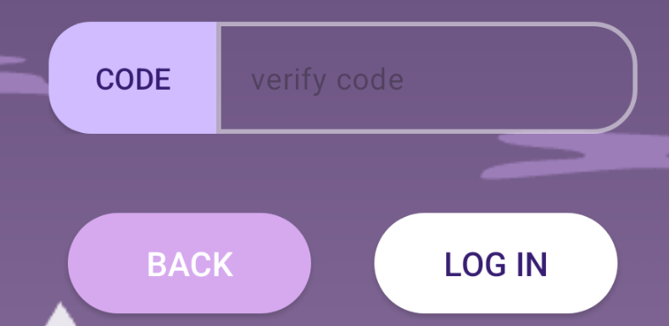
Improvement Effects
The clarity of buttons in the interface is improved

Slide 13
Improvement Effects
The clarity of buttons in the interface is improved
After the countdown page exits the software, the countdown will no longer reset
The user's privacy rights can be obtained successfully

Slide 14
Chapter 4
Group Collaboration
Team division of labor
Cooperation effectiveness

Slide 15
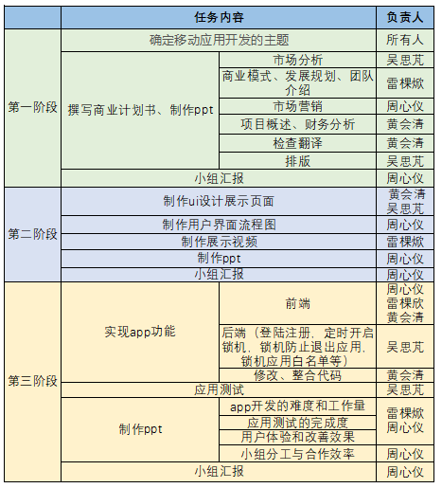
Team division of labor

Slide 16
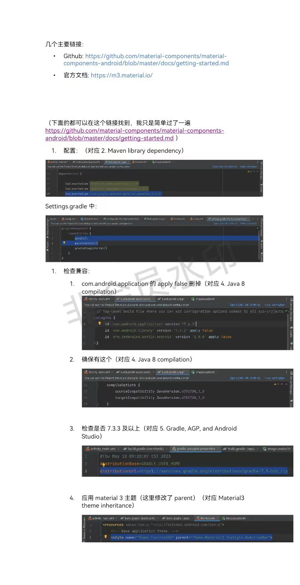
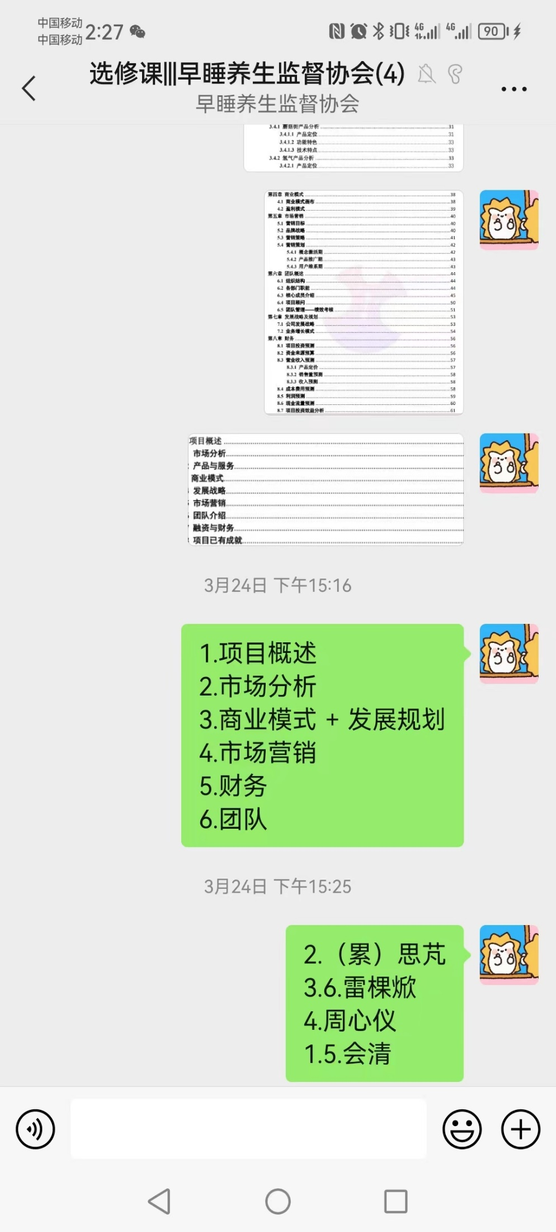
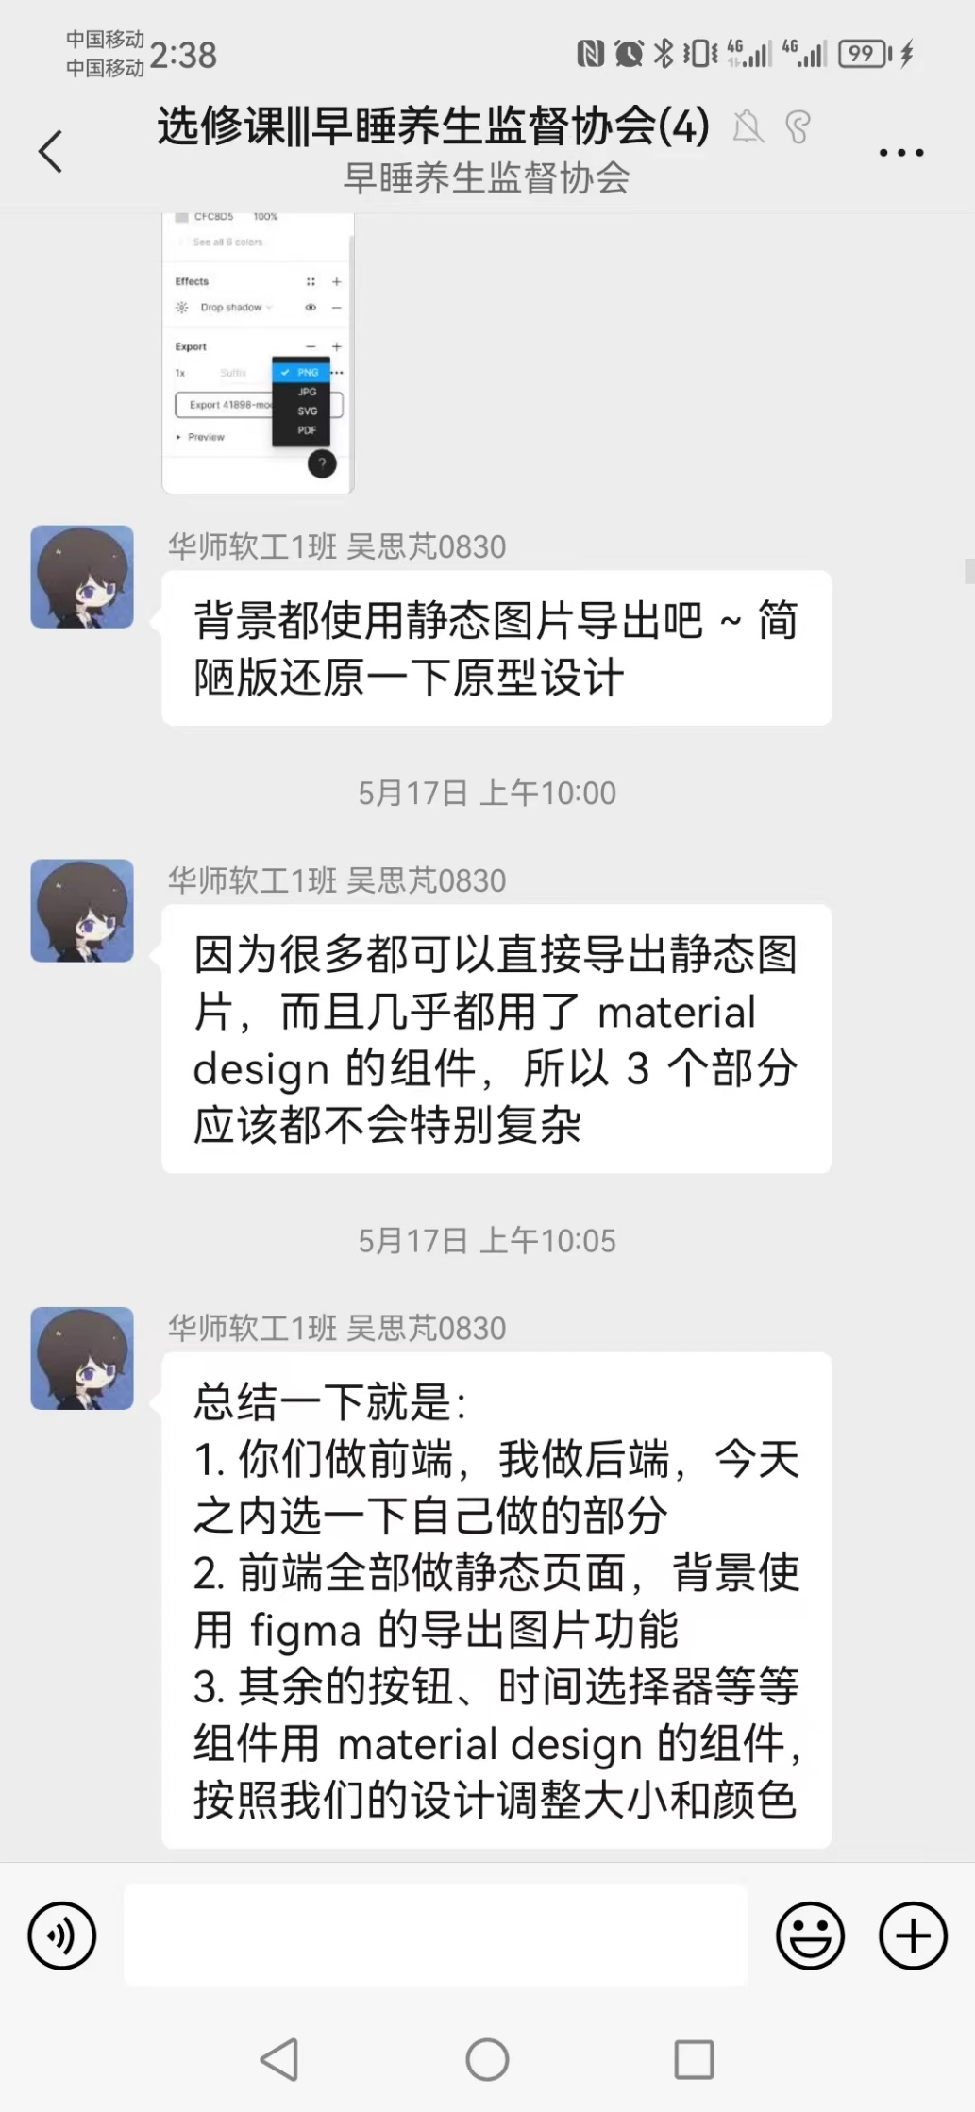
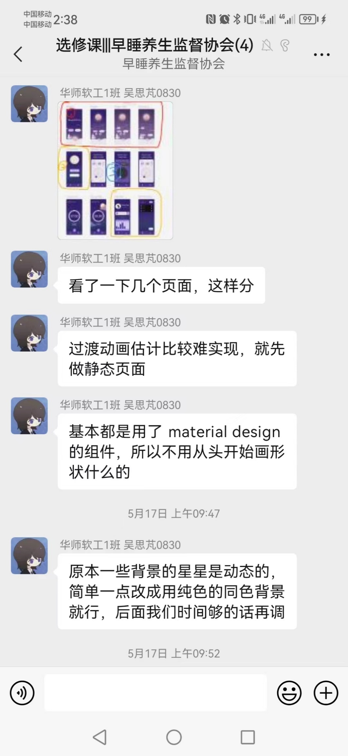
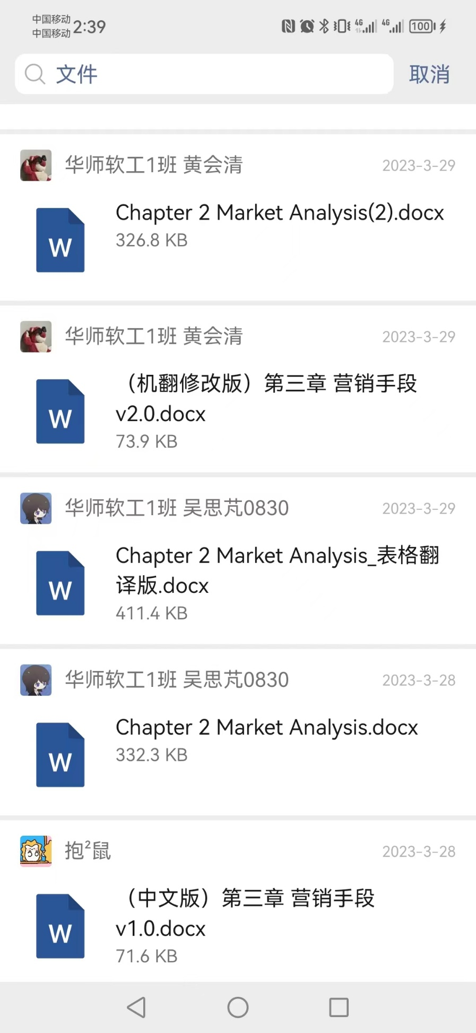
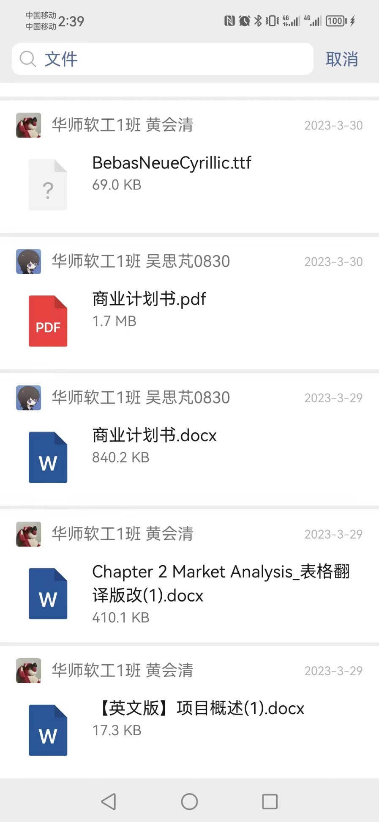
Cooperation effectiveness
Offline meeting
Rational division of labor
Complete the task on time
Bring out the best in everyone

Slide 17
Thanks for
listening!
Group member: SIPENG WU
KEXIN LEI
XINYI ZHOU
HUIQING HUANG

